Slide 1
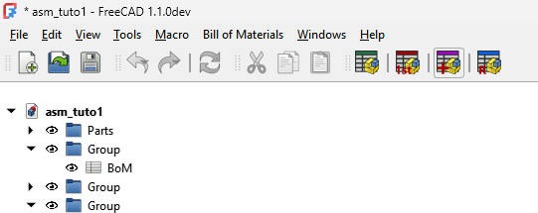

Slide 2
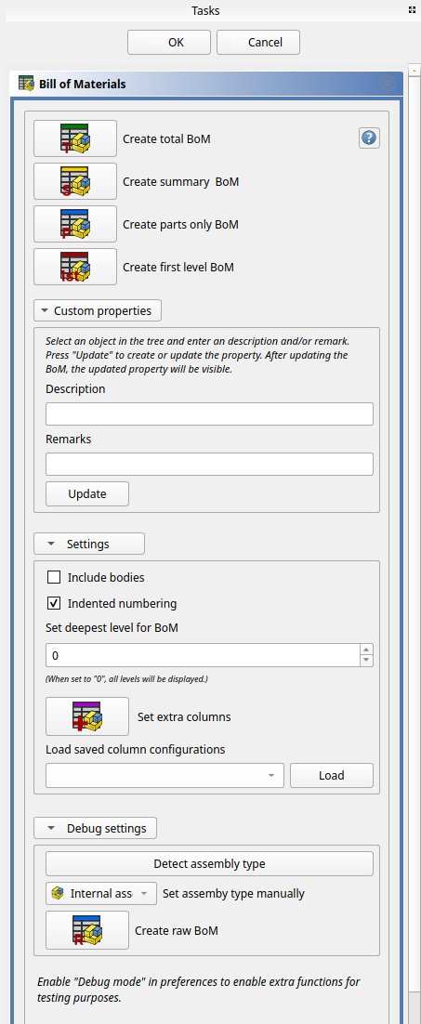
Help button
Create BoM buttons
Set custom properties
Settings for BoM creation
Debug commands

Slide 3
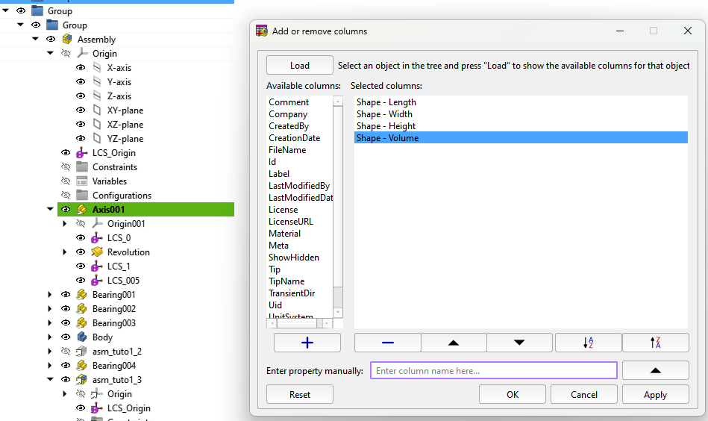
Load properties
Available properties
Commands for add/remove properties
Sort commands
Commands for add property manually
Dialog commands

Slide 4
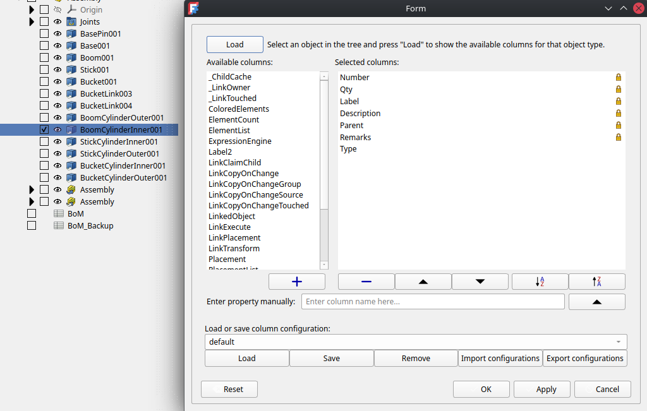
Load properties
Available properties
Commands for add/remove properties
Sort commands
Commands for saving or loading column configurations
Commands for add property manually
Dialog commands

Slide 5
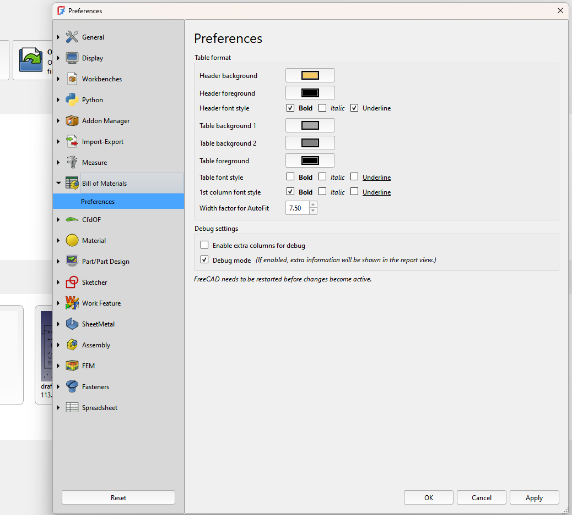
Style format settings for the BoM
Debug settings

